Slide 1
The University of Melbourne COMP90024 Cluster and Could Computing -- City Analytics on the Cloud
GROUP 58 Chao JIA (958973), Xiaojing DUAN (1109353), Xin WEI (980496)
Yaran SUN (859960), Zhenkai ZHANG (1076383)

Slide 2
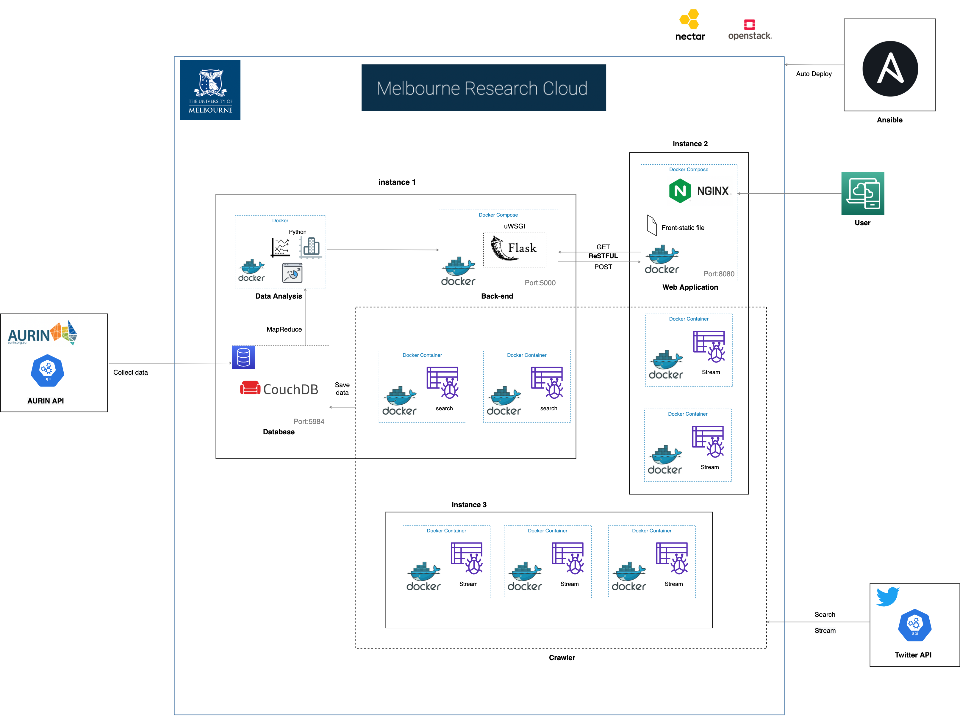
System Design

Slide 3
Scenarios
Greater Capital City Region
Median Income VS. Language
Median Income VS. Covid Frequency Tweet
Median Income VS. Sentiment
the Largest sub-State region (SA4)
Median Income VS. Language
Median Income VS. Covid Frequency Tweet
Median Income VS. Sentiment
Notes:
SA4: statistical area level4

Slide 4
Thank you!

